Slide 2

Ethics in the Age of Disruptive Technologies
Ann Skeet
Markkula Center for Applied Ethics at Santa Clara University

Slide 3
“What has struck me and has been really remarkable is that the conversation around AI has remained very bipartisan.”
Anna Makanju, vice president of global affairs, OpenAI

Slide 4
“Both parties hate it.”
Sam Altman, CEO, OpenAI

Slide 5



Slide 6

Photo by Katja Anokhina

Slide 7



Slide 8





ITEC Stages

Slide 9
Stage One:
Leadership Discernment and Direction
Leadership Buy-in, Commitment and Direction to a Responsible AI Strategic Initiative
Identification of an AI Ethics Champion
Technology Ethics Literacy for the Board and Senior Management
  Ethics in Tech Practice
  AI Ethics
Technology Ethics Policy Statement
  AI Ethics Policy Statement
Embedding technology ethics in organizations

Slide 10
“Literally every meeting I go to with a CEO, I ask the question: ‘Who in your organization is responsible for Responsible AI? And can they tell you, when you call, where AI is being used, what the risks are, and how they’re being monitored?’
And right now it’s about a 90% hit that they don’t have that person.”
Julie Sweet, CEO, Accenture
Embedding technology ethics in organizations

Slide 11
Stage Two:
Culture and Management Practices Assessment
Definition of a culture assessment instrument
Review of current policies and procedures that govern ethical behavior
Perception of corporate accountability both internal and external
Review of current ethical design requirements
Current user ethical use education and enforcement
Conditions that support the use of ethics in an organization
Notes:
Ann

Slide 12
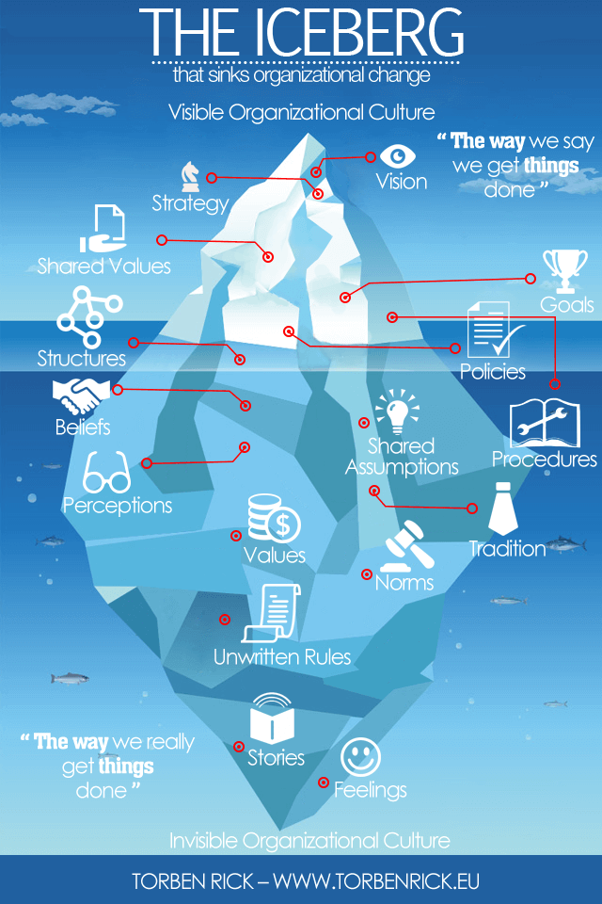
Culture Framework
Structural
org charts
internal participation mechanisms
HR management
Declarative
mission, vision
values
codes
pledges
internal messages to employees
More visible
Symbolic
rites
facilities
attire
exemplars
stories
Normative
beliefs
implicit standards
sanctions
taboos
Less visible
©1996 Gutierrez
Notes:
Ann
Cultures are systems, all parts of which are complexly interdependent
Key aspects of culture are values (what people hold dear) and behavior (what they do to achieve what they value)
The ”way things are done around here”
Some parts are more visible, some less so, which is part of why culture is so difficult to change; many companies lack insights around the full picture of their culture
A mix of elements contributes to the development of an ethical culture; in other words companies who rely too heavily on just a one or two of the elements are less likely to use ethics

Slide 13
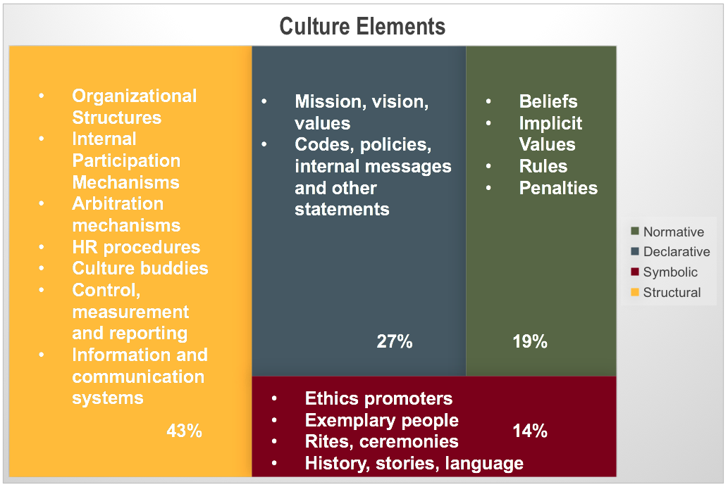

Slide 14
Conditions favoring ethics
Sense of responsibility to society
Attention to social issues, external claims, partnerships
Respect for moral autonomy and climate of mutual trust
Decentralizing decision making
Ethical deliberation
Specific way of making decisions
Relying on people to come forward and voice concerns
Data-driven
Involves those affected
Due care, downstream implications
Decisions and motivations openly shared
Notes:
Ann

Slide 15
Stage Three: Responsible Technology Governance Framework Definition
Development of anchoring and guiding principles
Anchoring/guiding principles & mission alignment
Development of ethical and humane use life cycle processes
Identification of ethical use education and compliance for users
Development of a set of Responsible Technology/AI performance measures and control processes
Notes:
Ann

Slide 16
Stage Four (a):
Mindset and Culture Management
Responding to the findings of your ethical culture self-assessment
Conducting a cultural elements inventory
Development an employee training curriculum and training matrix
Development of conditions that support the use of ethics
Identification of any decision making methods that need to be replaced with ethical deliberation practices
Alignment of employee evaluation and reward systems to support a culture for responsible technology/AI
Notes:
Ann

Slide 17
Stage Four (b):
Product and Service Life Cycle Management System
Building of the Responsible Technology Product/Service Life Cycle Management System
Development of stakeholder ethical value requirements
Employee technical curriculum and training matrix defined for technical employees
User ethical use education and compliance policies and processes updated or defined
Project management for product/service development identified
Notes:
Ann

Slide 19
Sample Design Process
(Possible integration of the tools in the Ethical Toolkit (in orange) with a conventional design workflow (in black)
Idea
Technical and Market Research
Case-Based Analysis (Case-Based Ethical Analysis of similar product ideas and their outcomes; what lessons/risks may transfer to this project?)
Sketch
Early Storyboarding/Wireframing of Product Functionality
Expanding the Circle (broaden your vision of stakeholder needs/capacities/interests beyond ideal user. Also, what are the dual-use cases?)
Feasibility Statement
Technical Risk Scanning
Technical and Ethical Pre-Mortem (assume this project fails. Where will the human/organizational failure points be? How can we avoid them?)
Notes:
Brian

Slide 20
Sample Design Process
(Possible integration of the tools in the Ethical Toolkit (in orange) with a conventional design workflow (in black)
Prototype
Build
Remember the Ethical Benefits of Creative Work (is this prototype still on track to deliver the envisioned benefits?)
Design (UX/UI)
Code (Front End Experience)
Expanding the Circle (continued: which users are we designing for/not designing for? Are we making the mistake of “designing for ourselves”?)
Development
Code (Back End Functionality)
(Keep) Thinking About the Terrible People (see above step; think again about dual-use contexts and whether your code invites harm there)
Expanding the Circle (is there anyone this prototype won’t work for, or won’t work as well? If so who, and why not? Can/must we fix that?)
Think About the Terrible People (what openings/incentives might this code leave open for bad actors to exploit/abuse?)
Remember the Ethical Benefits Again (is this product still on track to deliver the envisioned benefit, or is it missing something else?)
Notes:
Brian

Slide 21
Sample Design Process
(Possible integration of the tools in the Ethical Toolkit (in orange) with a conventional design workflow (in black)
Testing
Expanding the Circle (is our test group diverse/disinterested enough to reflect the real social impact of this tool? Or are we preaching to the choir?)
Release
Launch/Marketing
Closing the Loop: Ethical Iteration (what feedback channels have we built to give us reliable signals of ethical concerns about the product?)
Feedback
Customer Support/Quality Management
Expanding the Circle [are we soliciting ethically salient feedback from the full range of affected stakeholders (including non-users), or just a narrow set?]
Pre-Mortem (what test feedback might reveal an ethical failure point for this product in the future? Is there a bug fix here, or a deeper ethical flaw?)
(Keep) Thinking About the Terrible People (who may soon use this product in ways we didn’t want, and what is our plan to limit their harm?)
Closing the Loop (what are we doing with the ethically salient feedback we are getting? Who is responsible for analyzing/acting on it?)
UAT (User Acceptance) and Beta Testing
Notes:
Brian

Slide 22
Stage Five: Responsible Technology Management Ongoing Operations & Continuous Improvement
Develop Responsible Technology/AI Strategic Business Plans
Set Annual Operations Plan targets for Key Performance Measures
Provide a Responsible Technology Management System Annual Report
  Culture
  Life Cycle
Develop an annual Public Relations Plan and Calendar
Integration with ESG reporting
Notes:
Ann

Slide 23
Anchoring Principle
Our actions are for the
common good of
humanity and the environment.
Notes:
Ann

Slide 24

The Common Good
Anything that benefits and is naturally shared by all members of a given community.
If something is done for the common good, it is done to help everyone.
Introduction to ITEC
Notes:
Ann

Slide 25
Guiding Principles
Respect for Human Dignity and Rights
Promote Human Well-Being
Invest in Humanity
Promote Justice, Access, Diversity, Equity, and Inclusion
Recognize that Earth Is for All Life
Maintain Accountability
Promote Transparency and Explainability
Notes:
Ann

Slide 26
Common Pillars
IBM Pillars
Explainability
Fairness
Robustness
Transparency
Privacy
Microsoft Principles
Fairness
Reliability & Safety
Privacy & Security
Inclusiveness
Transparency
Accountability
Notes:
In 2016, Microsoft’s Tay chatbot was attacked on Twitter and began to produce offensive content, this provoked Microsoft to more carefully consider thinking ethically about its products [1]
In 2018, the Gender Shades study exposed IBM’s facial recognition software as racist and sexist, causing IBM to develop stronger processes for considering ethics in their technology products [2]

Slide 27
Respect for Human Dignity and Rights
Autonomy and self-determination
Empowerment of individuals
Safety, security, & reliability
Privacy and confidentiality
Right to appeal to a human
Right to an explanation
Participation in governance
Sample Action Principles
Select/develop AI models with consistent performance
Develop data storage guidelines
Develop AI concern escalation process, i.e. separate hotline for AI related issues
Develop human rights impact assessment tool and a process that defines when one should be conducted
Provide mechanisms for end users to appeal an AI system’s decision

Slide 28
Promote Human Well-Being
Beneficence & non-maleficence
Health & well-being
Safe and respectful working conditions
Access to education
Conflict resolution
Care for the vulnerable
Financial security
Emotional well-being
Purpose and meaning
Sample Action Principles
Identify jobs lost and gained due to AI; identify re-training opportunities
Develop reporting protocols for accidents with AI, loss of control of AI systems
Determine the meaning of “vulnerable”
Monitor effects of AI on non-vulnerable & vulnerable populations; close gaps between the two by raising standards, not lowering them.

Slide 29
Invest in Humanity
Good institutions
Long-term thinking
Civility & community building
Building good character
Creating healthy, inclusive cultures
Sample Action Principles
As part of employee evaluations, assess for attributes aligned with company’s values
Build/use AI systems that reinforce trust in standard accounting/financial practices
Assess the internal ethical culture, with special attention to AI-integration issues

Slide 30
Promote Justice, Access, Diversity, Equity and Inclusion
Sample Action Principles
Identify how feedback will be sought from stakeholders about how they are experiencing AI systems
Compare the data sets used to train AI against relevant population diversity
Test the AI system for potential biases
Choose AI systems with identifiable training data sets
Inclusion and non-discrimination
Fair economic conditions
Co-creation when working with the poor and marginalized
Subsidiarity
Peace through justice
Truth for the sake of justice
Governance as generative dialogue

Slide 31
Recognize that Earth is for All Life
Sample Action Principles
Track energy and water usage related to AI systems
Use AI only when the high impact to the environment is justifiable
Invest in the development or purchase of AI systems with lower computational requirements
Use server facilities with lowest carbon footprint
Disclose energy and water usage
Environmental sustainability
Biodiversity
Climate action
Earth is shared by all life

Slide 32
Maintain Accountability
Individual accountability
User accountability
Corporate accountability
Government accountability
Risk disclosure
Compliance
Sample Action Principles
Define ”abuse of” the product or service, revisit the definition regularly
State repercussions for abuse clearly, put in place enforcement mechanisms
Identify proper AI-infused product use and disclose user monitoring in simple language
Communicate risks, including categories of ethical risk with special attention paid to reputational, environmental, and human risks

Slide 33
Promote Transparency and Explainability
Transparency & trustworthiness
Simplicity
Fact-based decision-making
Openness on process and decision-making
Human Oversight
Interpretability
Reporting status and progress
Feedback channels for Explanations
Sample Action Principles
Know how AI models function; use tools for interpreting algorithms
Provide documentation for each model building step from exploratory data analysis to model building and then model deployment
Evaluate data quality and model performance when training AI models
Identify points where human oversight is appropriate and monitor

Slide 34
“Note on the illustration: The illustration for this story has been produced using generative AI. We identified two main concerns using AI for artwork: the ethics of attribution and of transparency. On transparency, we designed our prompts to ensure the resulting illustration is not mistaken for photojournalism or as depicting actual events or people. On the ethical pitfall of using generative AI models which exploit the creative efforts of humans without attribution, we chose the software deliberatively. Adobe’s Firefly is trained on content from its own stock library. This meant the compositional output would be more limited in range, a trade-off we considered less consequential than the exploitation of others’ labour.
ChathamHouse.org
Putting Principles into Action

Slide 35

Board Room Conversations

Slide 36
Risk Management
Risk of Disruption
Cybersecurity
Risk
Legal Risk
Operational Risk
Reputational Risk
Environmental Risk
Human Risk
Other Ethical Risk

Slide 37
AI Risk Management
Negative customer experiences; service interruptions
Illegally capturing data for training AI systems
Competitive efficiency; Labor disruption
Automated Hacking; Data Exfiltration
AI behaving counter to the company’s values
Use of common resources like energy & water
Customer and employee alienation
Bias in AI systems

Slide 38
Sample AI Metrics for the Board
Respect for Human Dignity and Rights
Data privacy breaches
AI models’ accuracy performance
Number of AI-related decision appeals received and their outcomes
Human rights impact assessment results
Promote Human Well-Being
Report on # of jobs lost/created due to AI implementation; # of employees re-trained for other work; # of employees retrained to do AI-augmented work
Incidents involving difficulties with or loss of control of AI systems
Results of worker survey specific to integration of AI in the workplace
AI Metrics for the Board
Notes:
Ann Framework for Workforce Well-being in AI integrated workplace

Slide 39
Sample AI Metrics for the Board
Invest in Humanity
Annual review of results of Ethical Culture Assessment
Social institutions the organization interact with via AI/automated systems identified
  Are these institutions strengthened or weakened by the interactions?
Report on involvement and support for industry-wide associations that strengthen industry and uphold standards on use of AI
Promote Justice, Access, Diversity, Equity, and Inclusion
Identification of AI training data sources
Incidences of bias identification in AI training data and corrective measures taken
Report on stakeholder dialogues; i.e. collection of input on use of AI from customers, employees, investors, and community representatives
AI Metrics for the Board
Notes:
Ann

Slide 40
Sample AI Metrics for the Board
Recognize that Earth is for All Life
Energy and water usage by AI systems; energy mix of electricity utilized
Investments in development or purchase of AI systems with lower computational requirements
Use of server facilities with lower carbon footprints
Maintain Accountability
Definitions of abuse of AI systems and associated repercussions; ensure their inclusion in user agreements, track the frequency and type of abuses
Review of company’s communication of AI risks to stakeholders
Number of people interacting with AI/automated systems
AI Metrics for the Board

Slide 41
Sample AI Metrics for the Board
Promote Transparency and Explainability
What tools for transparency, explainability, and interpretability are being used?
  Are these tools sufficient? Are AI systems consistently interpretable? # of incidents due to lack of interpretability
Evaluation of systems for transparency/opacity; risk analysis, opportunities to improve
Responsible AI Framework development: update on implementation; annual review once adopted
Annual review of Product/Service Life Cycle Management System, which includes
  Responsible AI Key Performance Measures
    Documentation of AI systems completed
Responsible AI Annual ESG report
AI Metrics for the Board

Slide 42
Board Actions for AI
Identify a board member and an executive providing dedicated AI ethics leadership
Train the board and senior team on tech ethics literacy
Articulate tech ethics policy and responsible AI principles list
  Ensure policies guide employees on appropriate use of AI in the workplace
Conduct an ethical culture assessment
Check AI systems for:
  Bias
  Manipulation
  Data poisoning
Ensure the company up to date with compliance
  EU AI Act, China’s CAC, US States & Fed (NIST), Singapore’s AI Verify
Develop a robust technology ethics framework

Slide 43

THANK YOU
Ann Skeet
Sr. Director of Leadership Ethics
Markkula Center for Applied Ethics
Santa Clara University
askeet@scu.edu
www.scu.edu/ethics
https://www.scu.edu/institute-for-technology-ethics-and-culture/
Google “The ITEC Handbook”

