Slide 1

ECI Update
Pat Harned, Ph.D.
Chief Executive Officer, ECI (Ethics & Compliance Initiative)

Slide 2

The Way Forward for ECI

Slide 3

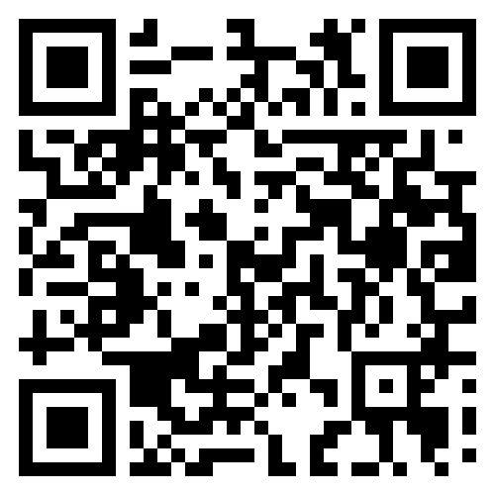
Thought Leadership
ECI’s Blue-Ribbon Commission on Corporate Impact and ESG
Helle Bank Jørgensen, CEO & Founder
Competent Boards
Michelle Breslauer, Transformational Governance Lead
U.N. Global Compact
Aron Cramer, CEO & President
BSR
David Curran, Co-Chair, Sustainability & ESG Advisory Practice
Paul, Weiss ESG and Law Institute
Abe Eshkenazi, CEO
Association for Supply Chain Management
Eitan Hersh, Professor of Political Science
Tufts University
Paul Knopp, CEO & Chairman
KPMG US
Bridget Kustin, Research Fellow; Qualitative Lead, The Ownership Project
Oxford Saïd Business School
Rick Lacaille, Head of ESG (Retired)
State Street Corporation
Sy Lorne, Vice Chairman & Chief Legal Officer
Millennium Management
Hon. Leo Mackay Jr. PhD LLD LHD, SVP - Ethics & Enterprise Assurance
Lockheed Martin
MEET THE COMMISSION
Notes:
Charge
Despite the current public debate (particularly in the US) about the role of the private sector in environmental, social and governance concerns, business has a unique and essential role in addressing the challenges of our world. Corporations (of all types and sizes) also have an ethical obligation to positively impact their stakeholders.
Goals
The Commission was convened to provide:
A charge to the business community, defining corporate impact on key stakeholders (internally and externally) as an ethics issue;
A definition of “business integrity” and evidence that it drives opportunity and long-term success, while addressing risk;
Principles to help companies integrate environmental, social and governance priorities into their strategy and operations, then and measure, communicate and report on progress;
Leading practices to highlight how business integrity principles can generate business opportunities and drive transparency;
Guidance for business leaders who encounter competing priorities and difficult or novel questions as they holistically implement business integrity in their strategy and operations; and
Targeted, practical recommendations for key positions within organizations that drive success, e.g., chief legal officers/general counsels, chief financial officers, chief operating officers, and chief ethics & compliance officers.

Slide 4
Blue-Ribbon Commission Members, cont.
Roberto Marques, Senior Advisor / Board Director
The Carlyle Group / Alcoa Corp
Dennis McGowan, Vice President, Professional Practice
Center for Audit Quality
Alison Omens, Chief Strategy Officer
JUST Capital
Alexandra Palt, Chief Corporate Responsibility Officer & CEO of the Foundation
L’Oréal
Kosmas Papadopoulos, Executive Director,
Head of Sustainability Advisory Services - Americas
ISS
Steve Scarpino, Chief Ethics & Compliance Officer
Citgo
Brad Smith, President & Vice Chair
Microsoft
Lex Suvanto, Global CEO
Edelman Smithfield
Larry Thompson, Former DAG; ERC Board Chair
Finch McCranie
Andrew Weissmann, Former Fraud Section Chief
US Department of Justice
Tensie Whelan, Director, Center for Sustainable Business
NYU Stern School of Business
Kim Yapchai, Board Member
DirectWomen
Paul Zikmund, SVP, Chief Enterprise Risk, Compliance & Information Security Officer
Berkadia
Notes:
Charge
Despite the current public debate (particularly in the US) about the role of the private sector in environmental, social and governance concerns, business has a unique and essential role in addressing the challenges of our world. Corporations (of all types and sizes) also have an ethical obligation to positively impact their stakeholders.
Goals
The Commission was convened to provide:
A charge to the business community, defining corporate impact on key stakeholders (internally and externally) as an ethics issue;
A definition of “business integrity” and evidence that it drives opportunity and long-term success, while addressing risk;
Principles to help companies integrate environmental, social and governance priorities into their strategy and operations, then and measure, communicate and report on progress;
Leading practices to highlight how business integrity principles can generate business opportunities and drive transparency;
Guidance for business leaders who encounter competing priorities and difficult or novel questions as they holistically implement business integrity in their strategy and operations; and
Targeted, practical recommendations for key positions within organizations that drive success, e.g., chief legal officers/general counsels, chief financial officers, chief operating officers, and chief ethics & compliance officers.

Slide 5
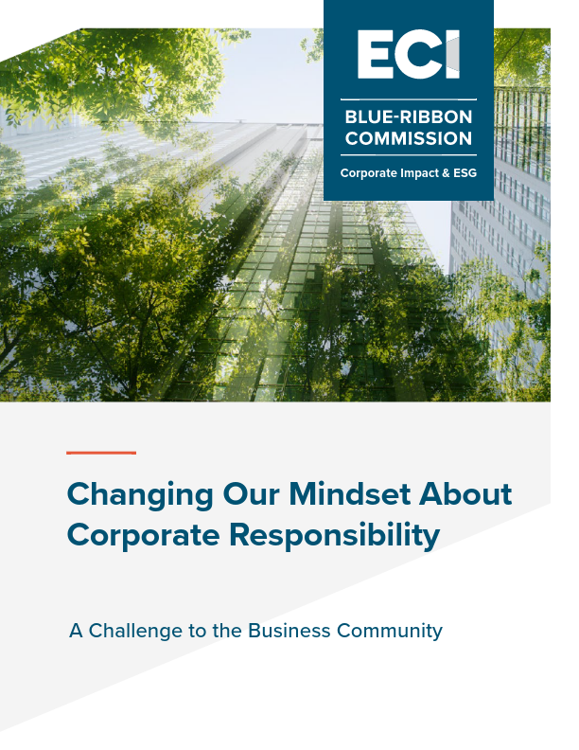
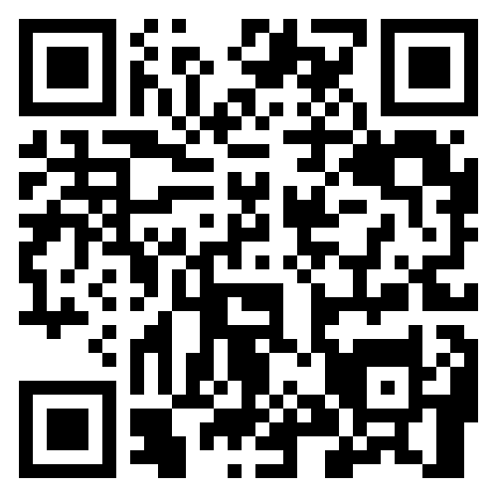
Download the Report, Available Now!

Slide 6

HQP → The Industry-Driven Framework
Meets and exceeds the minimum expectation of US law and regulation;
Has been proven to significantly transform workplace cultures and increase ethical conduct; and is
Regularly updated by corporate ethics & compliance professionals to reflect best practice and new compliance challenges.
  Hundreds of companies have assessed and modified their E&C efforts based on the framework.

Slide 7
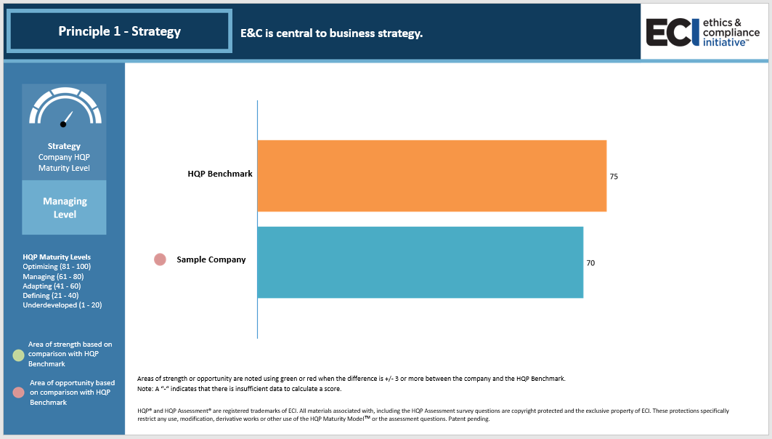

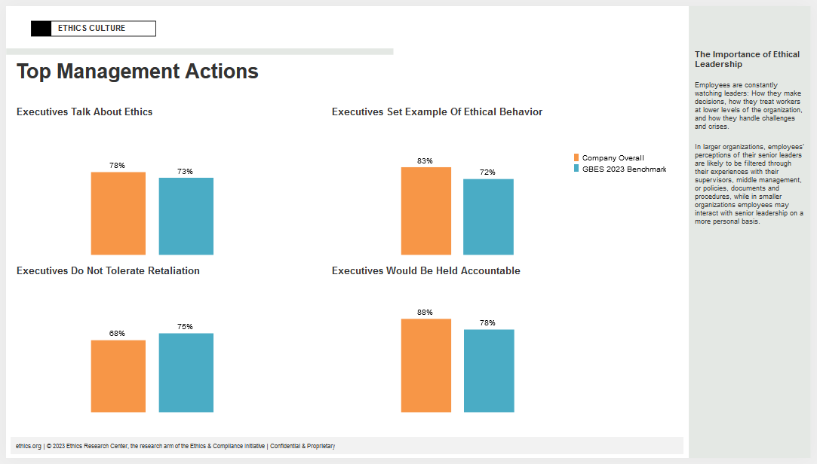


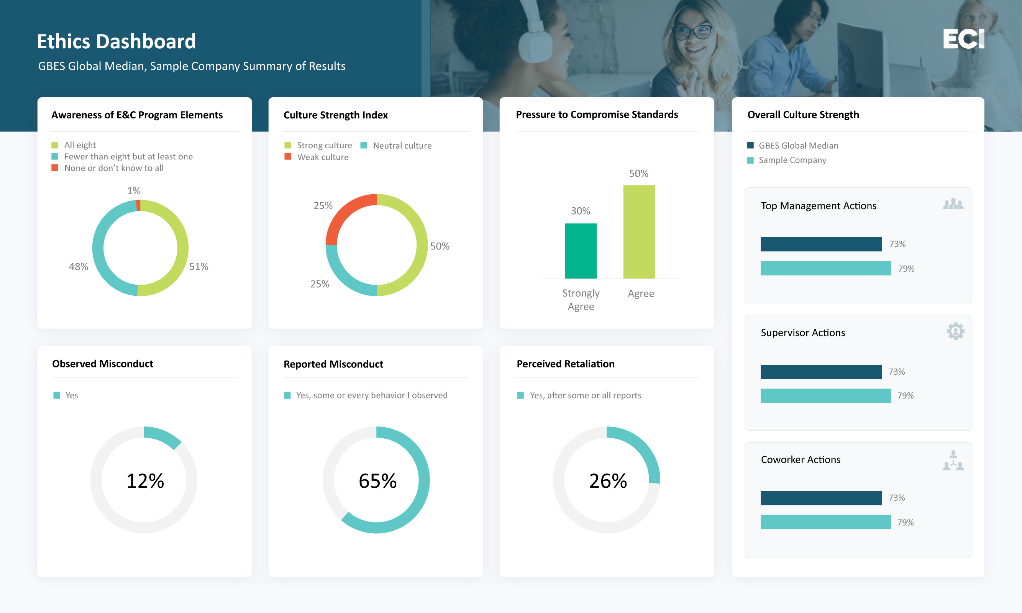

Expanding E&C’s Capabilities in Data Analytics
ECI houses over 20 million data points collected over the last 30 years from sources including:
      Company self-assessments against the ECI framework
      US and global survey research since 2000
      Industry and region-specific surveys since 2012
      Company-specific culture surveys since 2000
Proprietary & Confidential
Notes:
One of ECI’s premiere research publications is our Global Business Ethics Survey. The GBES is complimented by a collection of more targeted surveys and assessments that ECI has provided for our member organizations over the years, resulting in an unparalleled collection of data and information. This opportunity is about building on our history and this unique collection of information.

Slide 8
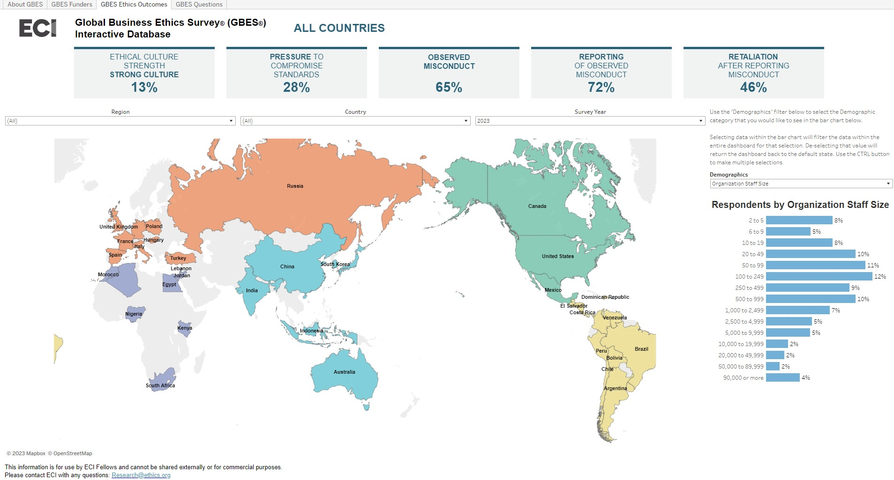
Continued Research & Working Groups
Current Working Groups:
Updating Your Investigator Training Program
Modernizing Codes of Conduct
Effective Whistleblowing Programs
Third-Party Risk & Extended Risk Management
Working Groups to Launch in Q2:
E&C Program Remediation and Post Settlement Obligations
Diversity, Equity, Inclusion and Belonging
Giving Voice to Values
The Interactive GBES Database Exclusively Available to ECI Members

Slide 9

2024 Carol Marshall Award
Nominations will be accepted from
April 1 through May 31, 2024
2023 Award Winner
Katie Lawler
EVP, Global Chief Ethics Officer
U.S. Bank

Slide 10


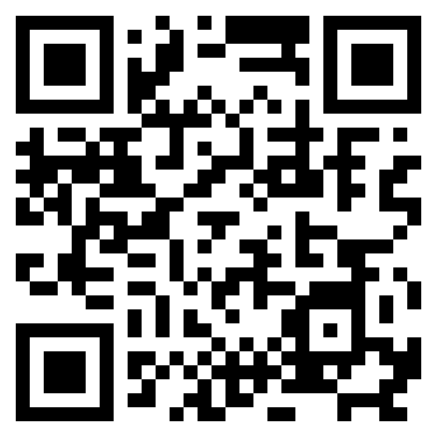
October 21-23
Focus on program progress based on HQP framework
Direct input on updates and certification process
Breakout sessions featuring best-in-class organizations
Access to new benchmarks
Policymaker & other prominent keynotes
Networking and fun in the sun at KPMG’s Lakehouse!
Scan to Register

Slide 11
Take advantage of your Member Benefits
Free implementation of HQP Assessment (E&C version)
Field ECI’s Culture Survey
Senior Advisor Consulting
Participate in Working Groups
Peer Leadership Groups
On-Demand Leadership Professional in Ethics and Compliance (LPEC) Training and Certification for your E&C team

Slide 12
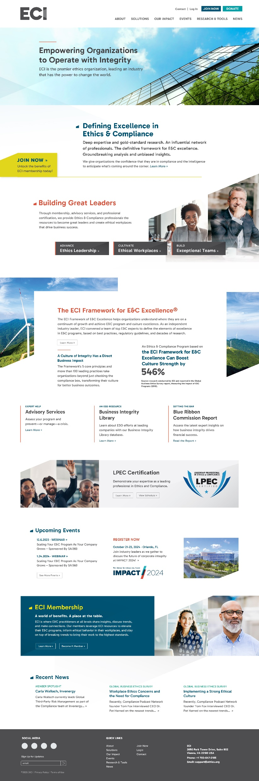
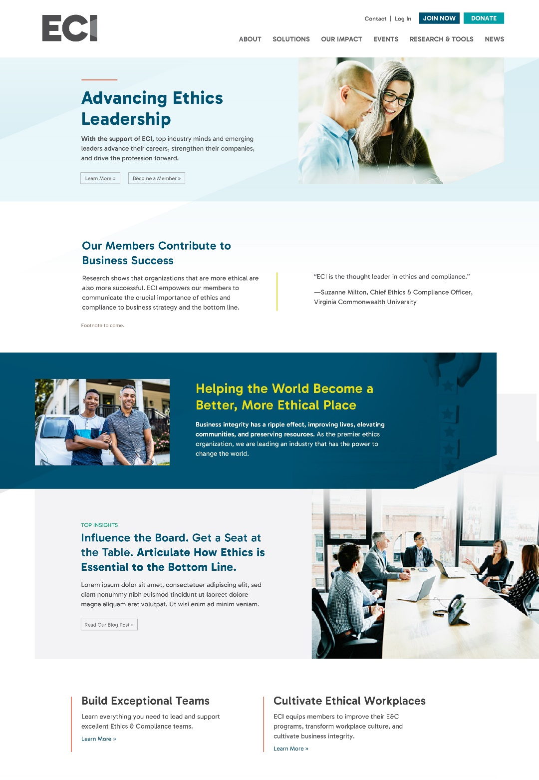
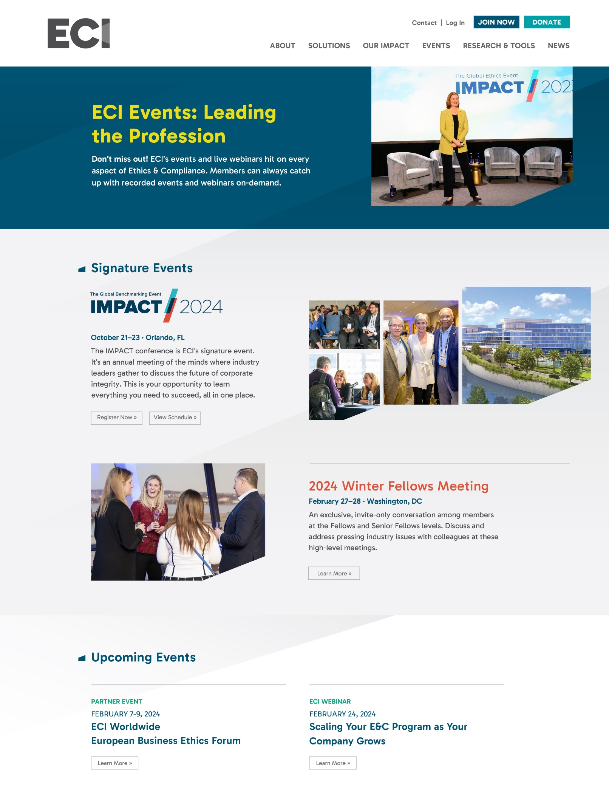
Preview of New ECI Website

