Slide 1
The Landscape – Legal, Regulatory, and Ethics Framework
Benjamin A. Powell
WilmerHale, LLP

Slide 2
Agenda
Legal and Business Risks
Legislative & Regulatory Landscape
Compliance in a Dynamic Legal Environment

Slide 3
Legal Risks
Hallucinations
Accuracy
Confidentiality and Data Privacy
Cybersecurity
Intellectual Property
Discrimination/Bias
Disinformation
Deceptive or Unfair Trade Practices
Ethics
Contracting

Slide 4
Legal Landscape
Biden Executive Order sets an ambitious agenda for federal agencies across a broad range of issues.
Federal agencies are releasing guidance on AI related issues within their jurisdiction and are figuring out how existing rules apply, though very little AI specific rulemaking (yet).
After a year of hearings on the issue and working groups at Congress, bills on narrow issues are being introduced.
States have been moving quickly to regulate: (1) comprehensive data privacy laws; (2) narrow use case laws; and (3) many AI bills introduced in 2023, some of which passed.
EU AI Act is a comprehensive risk-based law that will be influential, though other countries are taking a decidedly more pro-innovation approach
Voluntary frameworks have been instructive for companies trying to work through AI governance and related issues around technology adoption.

Slide 5
Executive Branch
Executive order consisted of approximately 120 directives to departments and agencies to produce AI standards and regulations in vast number of areas.
Significant roles for the Department of Commerce, Department of Homeland Security, and national security agencies.
Requires that developers of the most powerful AI systems share their safety test results and other critical information with the US government
Directs the development of standards, tools, and tests to help ensure that AI systems are safe, secure, and trustworthy
Flurry of activity at federal agencies in response to the Executive Order (e.g. Requests for Information, Notices of Proposed Rulemaking, Guidance)
Agencies like the FTC are applying existing legal tools to their fullest extent in enforcement actions—and to build on them where new ones may be needed.

Slide 6
Congress
Recognizes the importance of the issue and the speed at which the technology is moving; has held multiple hearings over the past year around all aspects of AI
Three potential approaches
Legislative directive to bolster the EO and prevent future administration from reversing it (e.g., directing NIST/Commerce to develop compliance frameworks to achieve the similar goals)
Comprehensive legislation (e.g., Sens. Thune (R-SD) and Klobuchar (D-MN) “AI Research, Innovation and Accountability Act”)
Targeted legislation where there is bipartisan support (or at least recognition of the issue)
Intellectual property
Elections and disinformation
Potential for AI to restart the push for a federal privacy law
Upcoming election in 2024 makes meaningful legislation in near term unlikely

Slide 7
State Activity
At the state level, legislatures are regulating AI in two primary ways: 1) incorporating AI provisions into privacy laws and 2) developing AI-specific rules for certain use cases (i.e., employment)
New state privacy laws define “personal information” broadly and create compliance obligations for companies that are subject to these laws (this is relevant for both training AI models and for AI use cases)​
Certain US state privacy laws are creating rights for residents to opt out of “profiling” in furtherance of solely automated “decisions that produce legal or similarly significant effects concerning the consumer”
Some jurisdictions have passed laws that address the use of AI narrow contexts, for example, in hiring and employment (e.g., NYC, IL)​
In the 2023 legislative session, at least 25 states, Puerto Rico, and DC introduced artificial intelligence bills, and 15 states and Puerto Rico adopted resolutions or enacted legislation (according to the National Conference of State Legislatures)​

Slide 8
Litigation
Litigation involving AI is relatively nascent, but rise of Generative AI has resulted in numerous cases being filed over the past year
Likely to see novel product liability claims and increased exposure for developers of AI systems
Issues
Privacy
Discrimination/bias
Intellectual property
Defamation

Slide 9
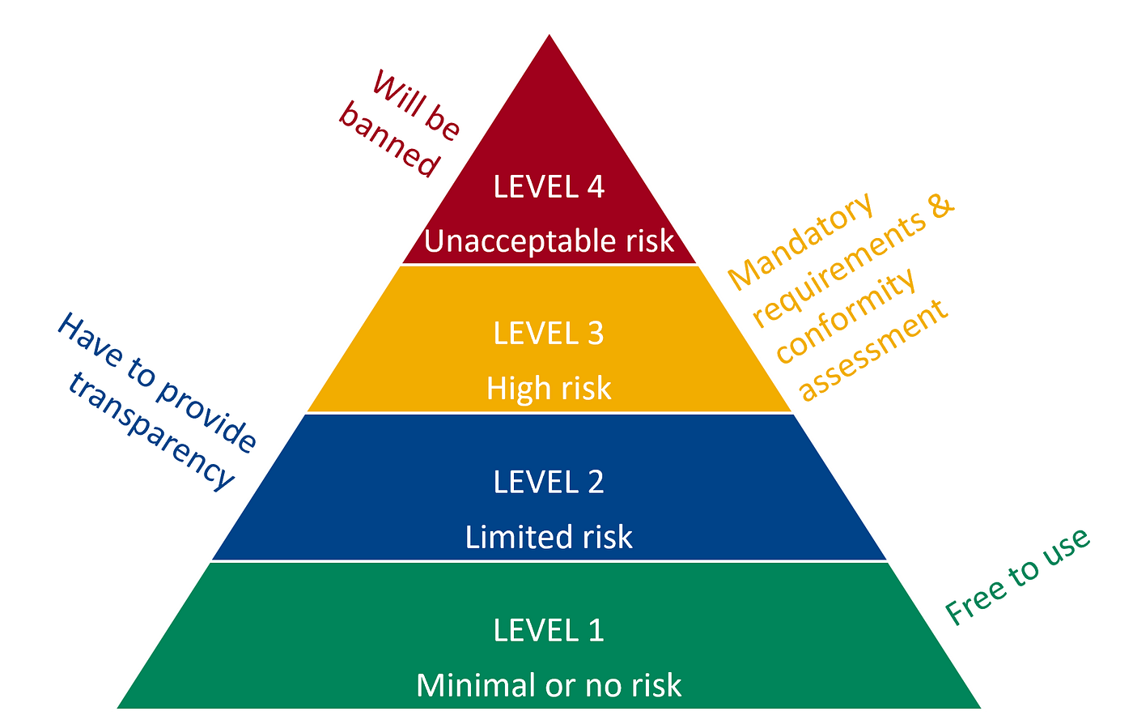
International
EU AI Act establishes a risk-based approach to regulating AI
South Korea and Japan are taking a flexible, principles-based approach
UK is taking a hands-off, pro innovation approach
China has AI regulations with broad coverage and expansive compliance obligations
Other countries, including Brazil and Canada, are exploring AI laws and regulations
EU AI Act Risk Levels

Slide 10
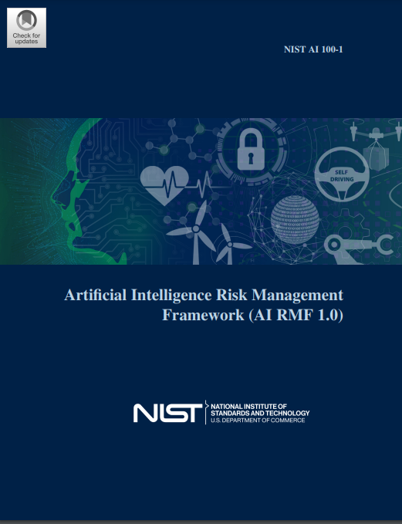
Voluntary Codes of Conduct and Frameworks
Tech Accord to Combat Deceptive Use of AI in 2024 Elections
Group of Seven nations Hiroshima Process International Guiding Principles for Advanced AI systems and International Code of Conduct for Advanced AI Systems
White House Voluntary AI Commitments
White House Blueprint for an AI Bill of Rights
NIST AI Risk Management Framework 1.0
Singapore Model AI Governance Framework

Slide 11
Compliance in a Dynamic Legal Environment
Legal landscape is developing rapidly, as are norms and best practices.
Legal advice needs to recognize both (1) where the law is, and (2) where enforcement may go without the law.
Recognize that the speed at which technology and law are changing, and the likely inconsistencies across legal regimes, necessitates flexibility
Some challenges are novel and specific to AI, but some are well-known
Benchmarking is important, but all companies are situated differently with different cultures/risk tolerances
Important to engage the Board on these issues early on
Leverage frameworks and existing compliance programs
Use sound judgment and have a consistent and principled approach in the absence of clear legal guidance

