Slide 1
Governance of AI for your E&C Program and your Organization – Panel Discussion
Matt Rotelli
Vice President for the Bioethics Program, Eli Lilly
Carl Hahn
VP and Chief Compliance Officer, Northrop Grumman
Nick Hamilton
Head of Governance and Compliance, OpenAI
Facilitator: Tim Lindon
ECI Senior Advisor

Slide 2
AI Governance
Carl Hahn
Corporate Vice President, Chief Ethics & Compliance Officer

Slide 3
Standards of Business Conduct - AI

Slide 4
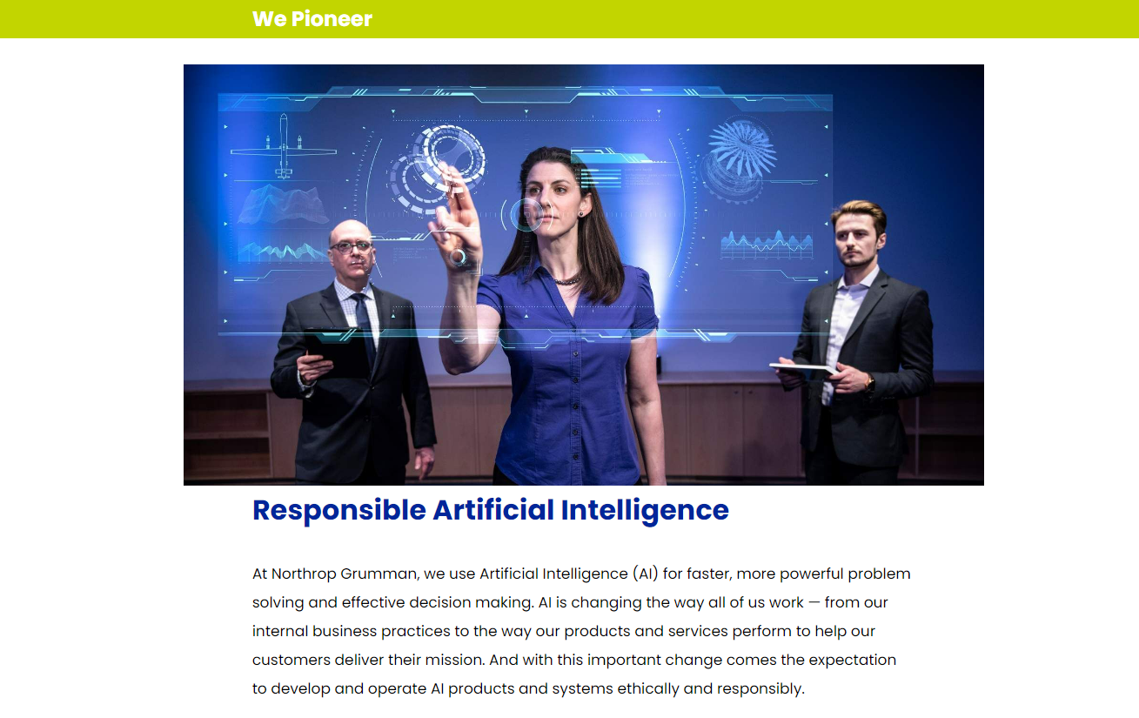
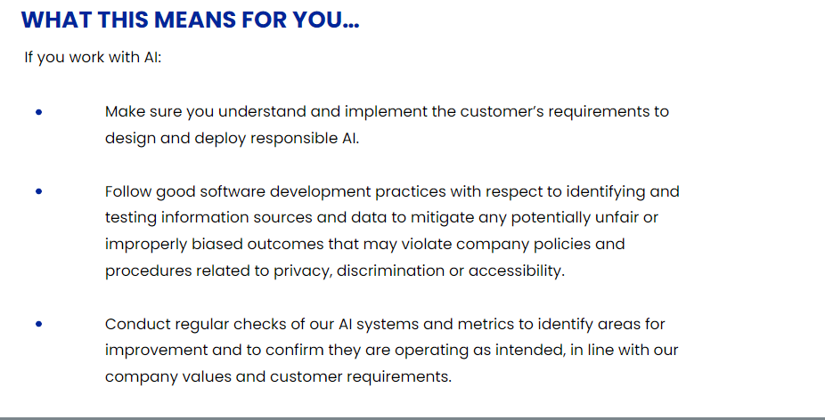
Standards of Business Conduct - AI

Slide 5
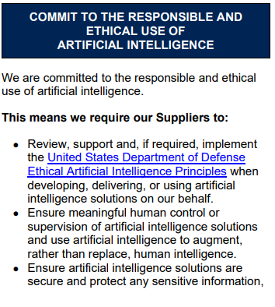
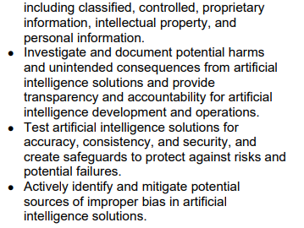
Supplier Standards of Business Conduct - AI

Slide 6
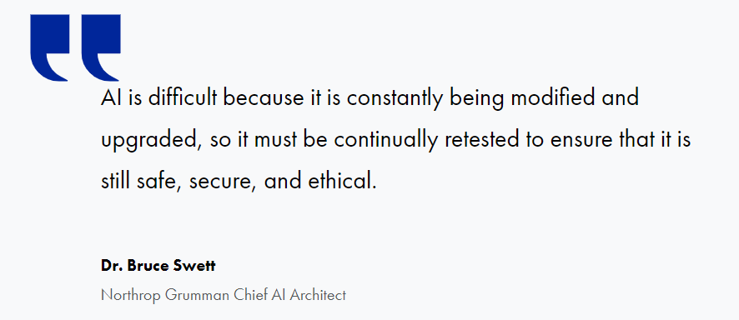
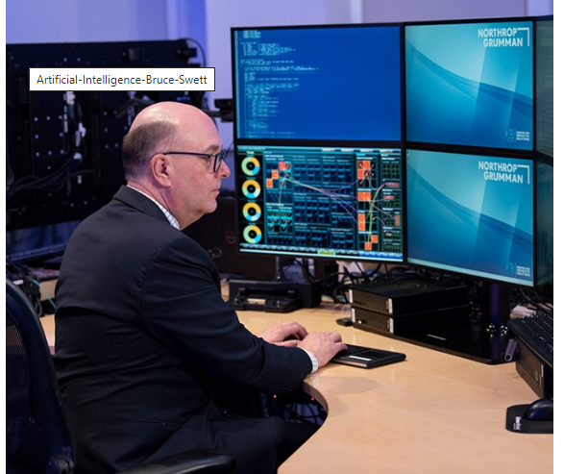
AI Ethics – Building Security and Responsibility into Intelligent Systems

Slide 7
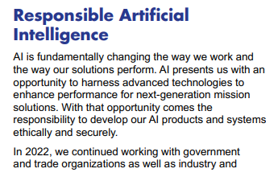
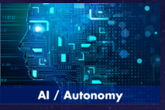
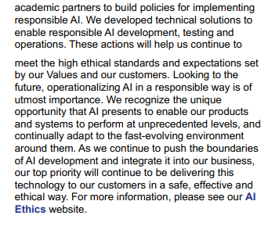

Slide 8
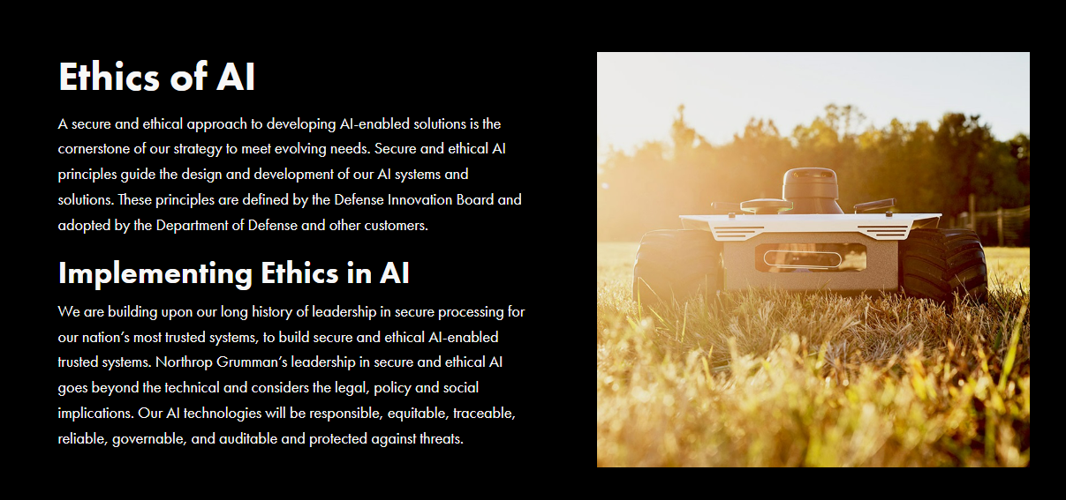

Slide 9
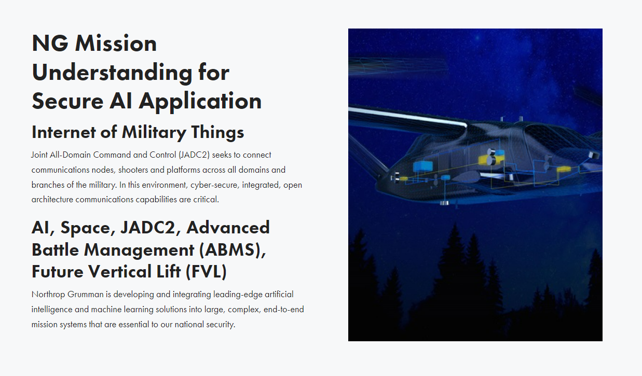
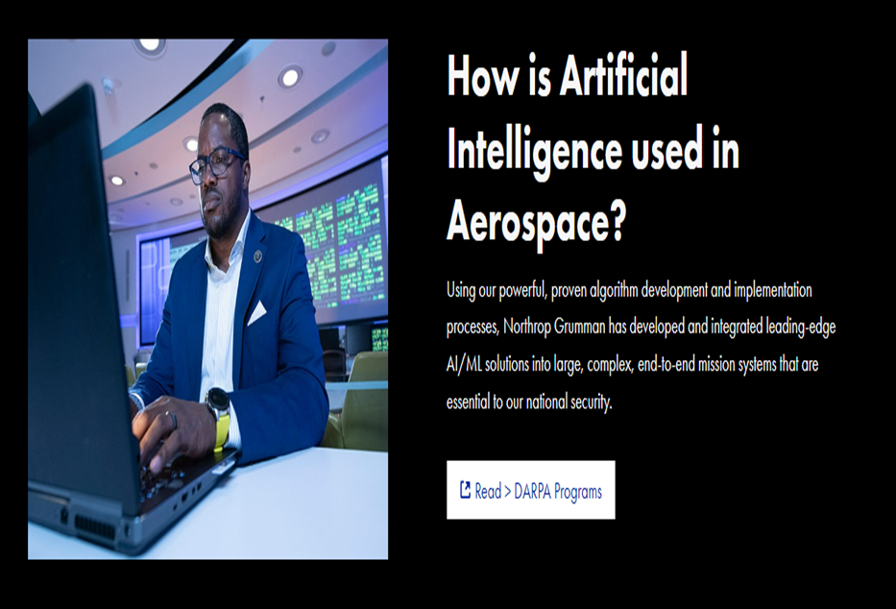

Slide 10
Supplier Standards of Business Conduct - AI
Our Products and Services

