Slide 1


Artificial Intelligence, Business Ethics and the Value of Choice
Vikram Bhargava
Assistant Professor of Strategic Management & Public Policy, George Washington University School of Business

Slide 2

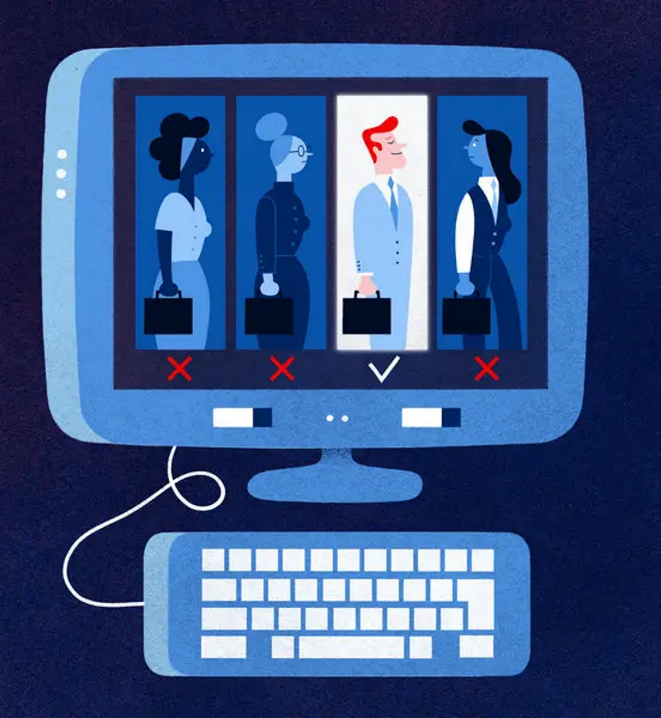


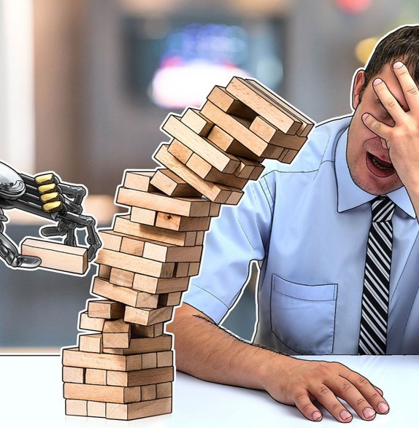
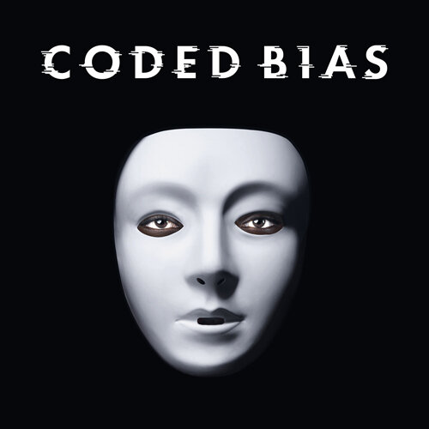

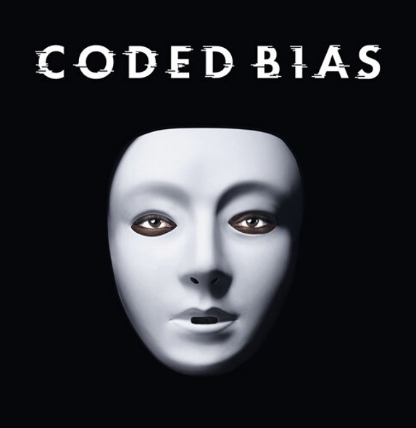


Slide 3
Suppose these bad outcomes are ultimately engineered away.
…are there any ethical concerns that remain?

Slide 4

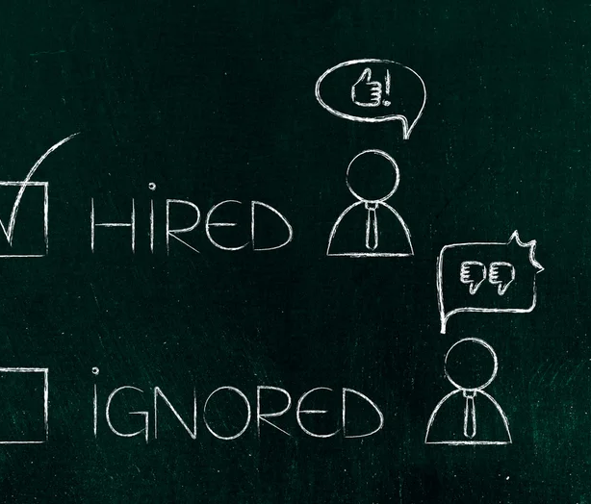
Why conduct interviews?

Slide 5


(Cappelli, 2019)
(Muehlemann & Strupler Leiser, 2018)
(Elfenbein & Sterling, 2018)
(Society for Human Resource Management, 2017)

Slide 6
Why conduct interviews, despite the enormous costs associated with the process?

Slide 7

The Traditional View of Interviewing
Interviews help predict performance and fit in relation to the job requirements.
(Dessler, 2015, 2020; Mathis, Jackson, Valentine, & Meglich, 2016; Mondy & Martocchio, 2016).

Slide 8
“Why conduct interviews?” is a more difficult question than it seems.

Slide 9
The Two Threats
The traditional view of interviewing faces two threats:
(i) The Behavioral Threat
(ii) The Algorithmic Threat
9

Slide 10

The Behavioral Threat
A large body of behavioral evidence suggests we’re bad predicters of performance and fit.

Slide 11
But what’s the alternative?

Slide 12

The Algorithmic Threat
Algorithms already have a superior track-record of predicting fit than humans, even experts, in many domains.

Slide 13
The Threat to the Traditional View of Interviewing
The Interview Puzzle
If the traditional view is the whole story—that interviews are for predicting performance and fit—then it seems the practice is left on feeble grounds.
Not only is interviewing costly, but we’re also bad at it and may have better alternatives.

Slide 14
If the traditional view is correct, interviews seem (at best) an archaic HR practice, or (at worst) blatant wastefulness sustained by irrational managerial overconfidence.

Slide 15
A Value of Choice Theory of Interviews

Slide 16
Primary Claims:
Interviews should be abandoned, if they’re solely about predicting performance and fit (as the traditional view posits).
But interviews are not solely about predicting performance and fit.
Interviews implicate overlooked ethical values and thus can be worth preserving, despite the behavioral and algorithmic threats.
Something of ethical significance risks being lost, were we to abandon interviews.

Slide 17

Vindicating interviews
Vindicating the practice of interviews.
Interviews can be vindicated once we see there are additional values implicated in the practice of interviewing, beyond predicting fit and performance.

Slide 18

T.M. Scanlon
The Value of Choice
“People often have good reason to want what happens in their lives to depend on the choices they make, that is, on how they respond when presented with the alternatives” (2013)

Slide 19

Value of Choice
Three kinds of value can be created through making a choice.
Instrumental value
Representative value
Symbolic value
Notes:
Representative: value that’s realized in virtue of when my making the choice alters the meaning of the outcome of the choice—and this value is realized even if my making the choice is instrumentally worse at achieving the outcome, than an alternative method of decision-making (e.g., an algorithm, a coin flip, deference).
For example, it’s important that I am the one who chooses a gift for my significant other, not because I’m more likely to satisfy their preferences than they are (were they to select the gift themselves), but rather because there is value in the fact that I was the one who chose it, and in choosing it, I expressed myself (e.g., my desires, beliefs, attitudes toward my significant other) through that act.
Symbolic: certain choices reflecting that one is a competent member of the moral community who has standing that is “normally accorded an adult member of the society” (Scanlon, 1998, p. 253). For example, if I, as an adult, were not permitted to choose my bed time, this is demeaning and infantilizing.

Slide 20
Thus, when a choice is abdicated, at least one of these three values are candidates for the value that would be lost.

Slide 21
Back to interviews.
Instrumental Value (The Traditional View)
Representative Value: Choosing our colleagues is a way “to see features of ourselves manifested in actions and their results” (Scanlon, 1998, p. 252)
Symbolic Value: Insofar as industry norms involve choosing one’s colleagues—i.e., people they’d collaborate with, but also, befriend, commiserate with—depriving people of that choice, can result in loss of symbolic value.

Slide 22
“The reasons people have for wanting outcomes to be dependent on their choices often have to do with the significance that this dependence itself has for them, not merely with its efficacy in promoting outcomes that are desirable on other grounds” (Scanlon, 1998, p. 253).

Slide 23
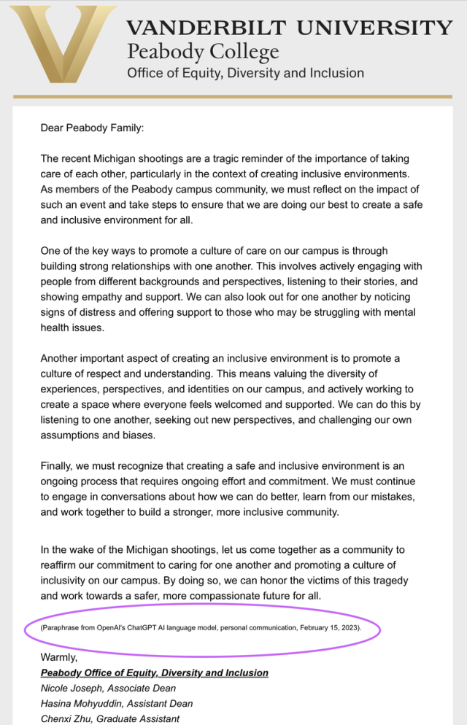


Slide 24
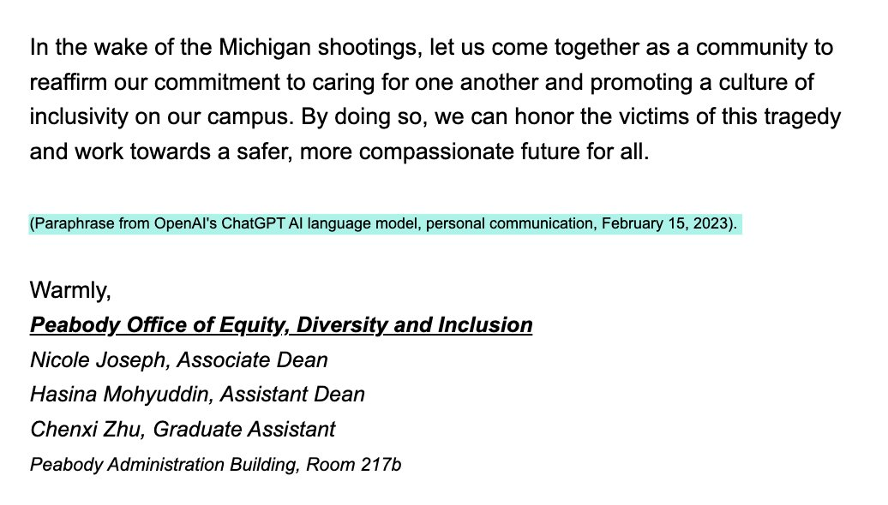

Slide 25
The fact that the loss of representative and symbolic value is risked when foregoing interviews generates pro tanto ethical reason to preserve interviews, despite the behavioral or algorithmic threats.

Slide 26
Conclusion

Slide 27
Conclusion
If the traditional view captures all there is to interviewing, then the justification for the practice is undermined by the behavioral and algorithmic threats.
However, interviews can be vindicated once we recognize that there are a broader set of values realized through interviewing.
More generally, even if the bad outcomes associated with algorithms are ultimately engineered away, it still doesn’t settle the question of whether managers should abdicate certain choices to algorithms.

Slide 28
Thank You
I welcome your questions, suggestions, and objections.
Vikram R. Bhargava
vrb@gwu.edu

