Slide 1
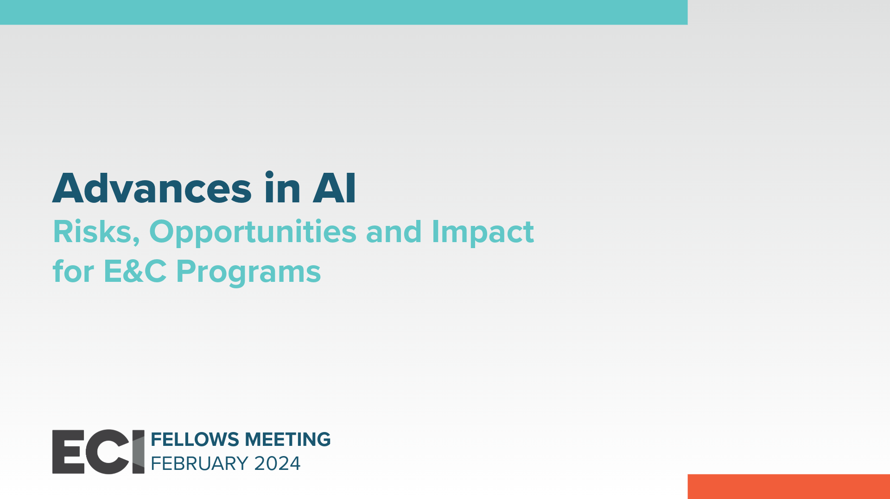

Slide 2

AI Moving Beyond Big Data Analytics/Machine Learning
AI Enhancing and improving efficiency of Compliance to adhere to IRS, SEC, FCPA (Foreign Corrupt Practice Act) regulations
Frank P Orlowski
Managing Director Alvarez & Marsal
Cell: +1 917-821-2147

Slide 3

Top Seven Practical AI Uses to Enable Compliance and Controls
Fraud Detection: AI can analyze large volumes of financial data in real time to detect unusual patterns or suspicious transactions that may indicate fraudulent activities. AI can not only continuously learn from past data, but it can also improve its ability to identify new fraud patterns. This will prove a valuable tool in identifying new “trends” in fraud or non-compliant activity to stay one step ahead of the violators.
Anti-Money Laundering (AML) Compliance: AI can assist financial institutions in complying with AML regulations by scrutinizing customer transactions, monitoring suspicious activities, and generating alerts for further investigation. This can be done in all languages, including with unique/special Asian Language characters that were previously difficult to translate into readable data.
Transaction Monitoring: AI-powered systems can monitor financial transactions and flag any that deviate from established patterns or are potentially non-compliant. This helps to ensure adherence to regulatory requirements and prevents money laundering or illegal activities. This includes T&E Processing, vender payments, and cash advances
Automated Reporting: Beyond conventional “batch processing” and traditional “workflow” of reports, AI can now automate the generation of regulatory reports required by government authorities.

Slide 4
Top Seven Practical AI Uses to Enable Compliance and Controls (Cont.)
5. Risk Assessment and Mitigation:
AI models can analyze vast datasets to assess risks associated with investments, loans, or other financial decisions. The great advantage of the new AI capabilities in this area includes identifying the wide range of existing assets and loans instead of a more narrowed bank of financial vehicles. It aids in identifying potential issues and allows for better-informed risk management strategies.
    This includes monitoring vendors/clients that are arm's length of a corporation to ensure compliance, which regulatory acts such as FCPA require. (large amounts of data outside the control of an organization)
6. Audit Support:
Gone are the days of Yellow Workpapers in Binders and traditional audit software that rely on “If/then” statements. AI can now assist internal and external auditors by quickly analyzing vast amounts of financial and operational data, identifying potential compliance issues, and suggesting areas for further examination.
7. Customer Due Diligence:
AI-driven tools have always assisted in verifying customer identities, conducting background checks, and assessing potential risks associated with new or existing customers. AI can help look to the future and analyze more intangible/predictive data to ensure that an individual or an entity that may not be high-risk today, but in the medium or long term will present issues.

Slide 5
However, with all of these practical uses of AI
there needs to be tighter compliance and controls on AI itself
AI is the equivalent of giving a 14-year-old access to all of
the data and information in the world without any life experience or discipline

Slide 6

Insert Divider or Transition Messaging

Slide 7
Click to add session content

Slide 8
Click to add session content

Slide 9
Click to add session content

Slide 10
Click to add session content

